Slide 1
INSURANCE POLICY MANAGEMENT
GROUP 5

Slide 2
TEAM MEMBERS
EMPLOYEE ID | NAME | MODULES ASSIGNED
2563893 | Sourav Kumar | Searching and Filter
2563092 | Bhushan Bisane | Delete user, Update password & Decline order
2563289 | Barkha Soni | Add user, View all user & Update user
2563208 | Bandari Sai Teja | Add order, Approve & Waiting order
2563534 | Wellwin K M | View all user question, Add user query & Login user
2563060 | Vaishnavi Arunachalam | Admin Login & Viewall
2563701 | Katta Vivek | Add Policy, Delete Policy & add general query
2563219 | Pokala Mohan Krishna | Update policy, Viewall Policy & logout user
2563578 | Harsh Shukla | Admin logout, View order & view all contact us

Slide 3
INTRODUCTION
The Insurance Management System is a user-friendly solution designed to offer financial security in an uncertain world. It features two primary user roles: administrators and customers. Admins can efficiently handle admin accounts, customer profiles, policy categories (Life, Health, Motor, Travel), and policy management (addition, updates, deletion, approval). They can also track policyholder stats, handle inquiries, and monitor approvals. End users can create accounts, update personal info, view policies, and apply, pending admin approval. The system provides a seamless experience for tracking policy status and communicating with administrators, ensuring easy and confident insurance management.

Slide 4
OBJECTIVE
The main objectives of our project are as follows:
Facility to store the information of new customer & different types of Policy details & Policy Price .
Interest to develop a good user friendly website with many online transactions using a database.
To fulfill basic requirements and use of ease to book online insurance Policy, through online Policy booking system.
To increase our knowledge horizon in technologies like spring boot, postman etc.
To reduce the money and efforts in managing the record and saving time.

Slide 5
TOOLS AND TECHNOLOGIES
Server-Side: Spring Boot Data JPA
MicroService : Feign , resilience4j, sleuth zipkin
Data Base : MySQL , Hibernate
Server: Tomcat, Config , Eureka , Github
Operating System: Windows 10/11

Slide 6
ADMIN & USER ROLES
ADMIN ROLE | USER ROLE
Login Process (Sign In) Add/Delete policy View and Update Policy Details Enable or Disable Policy Manage Policy/ Order | Registration Process (Sign Up) Login Process (Sign In) Booking Policy Ask Help or Suggestions Filter & Search based on end user needs

Slide 7
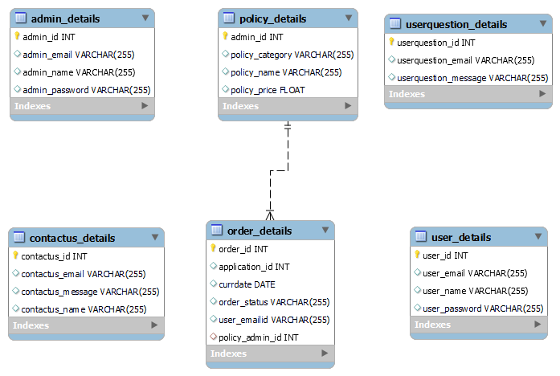
DATABASE SCHEMA

Slide 8
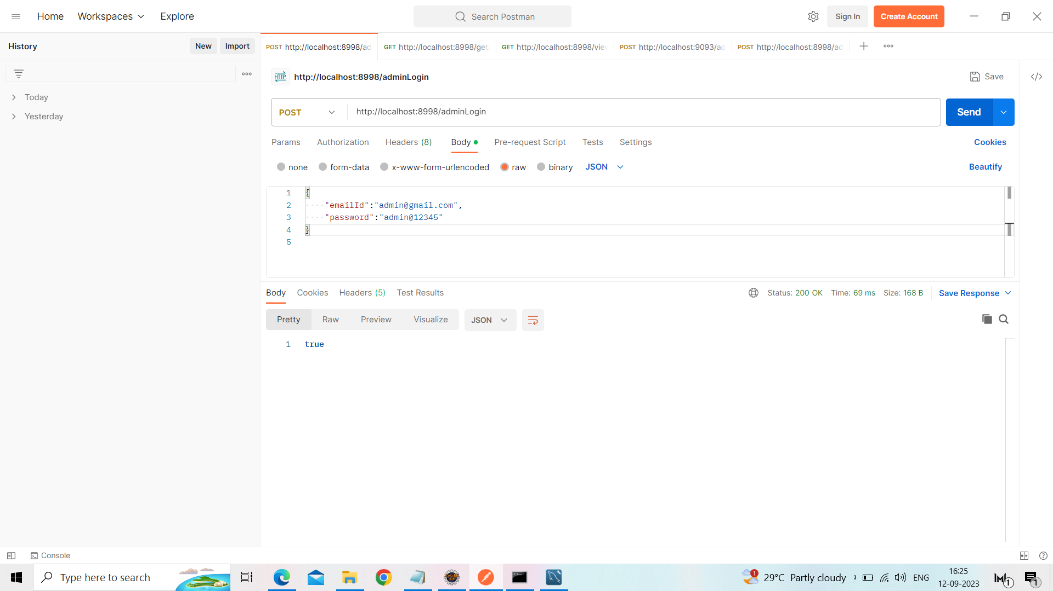
Admin Login

Slide 9
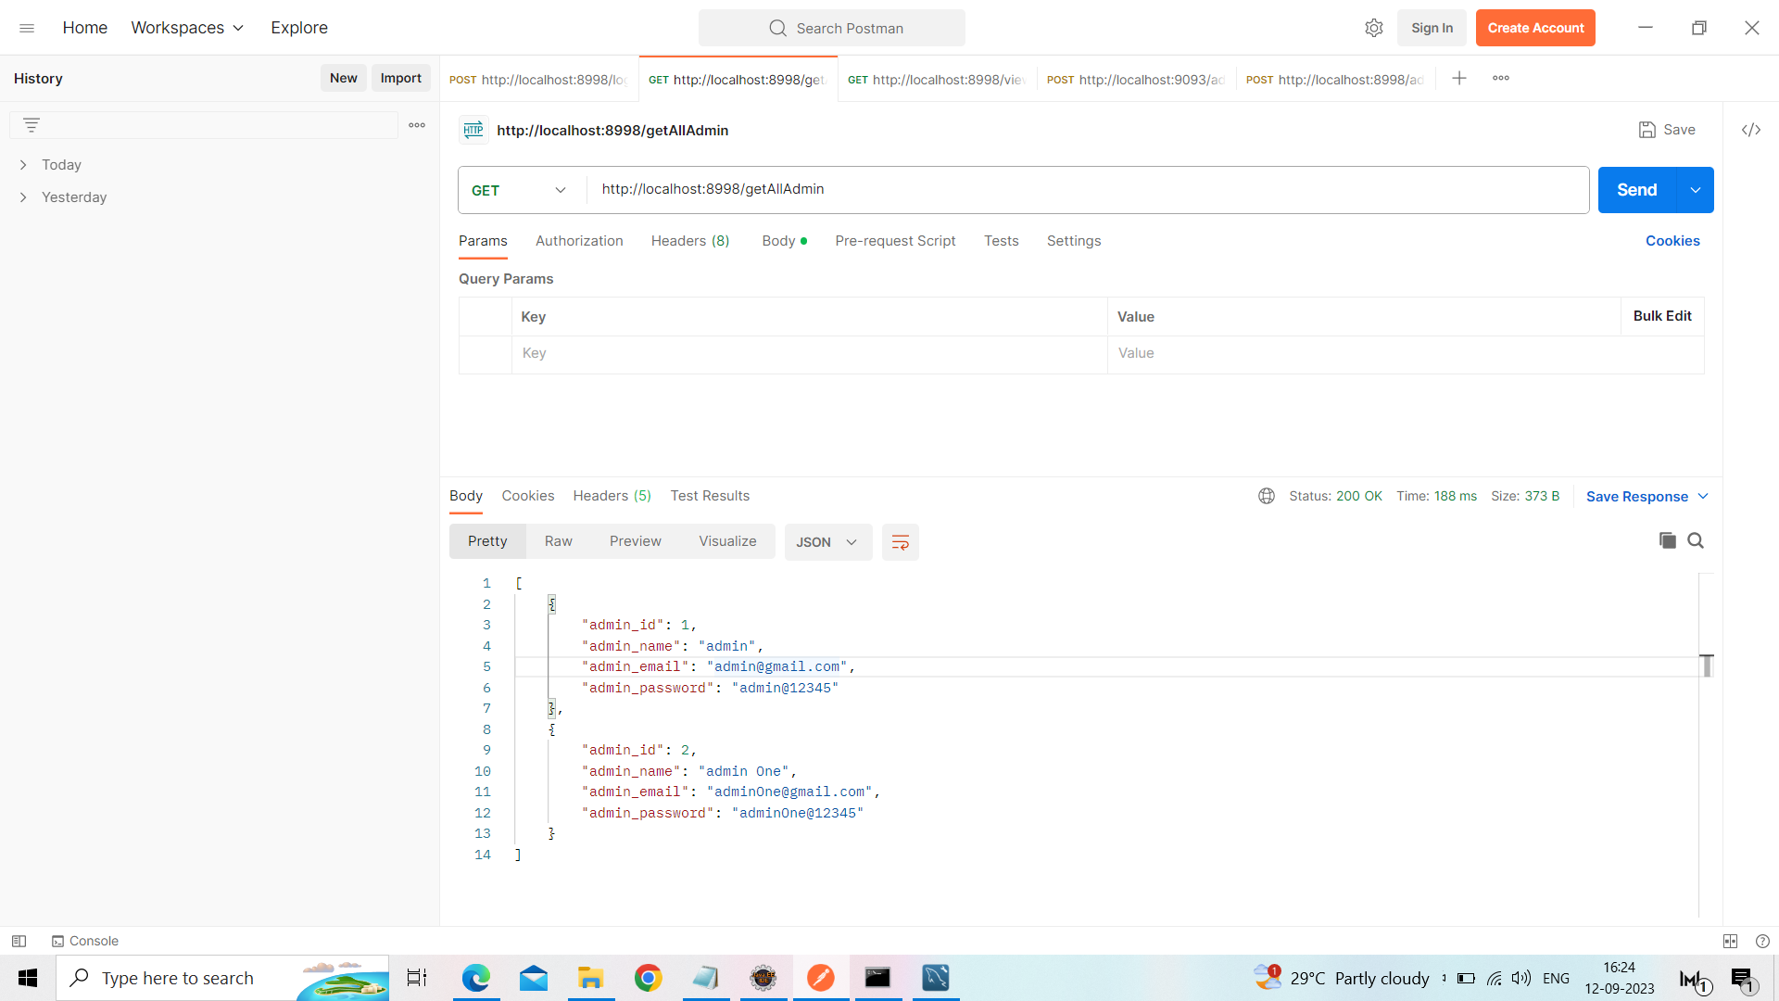
Get All Admin

Slide 10
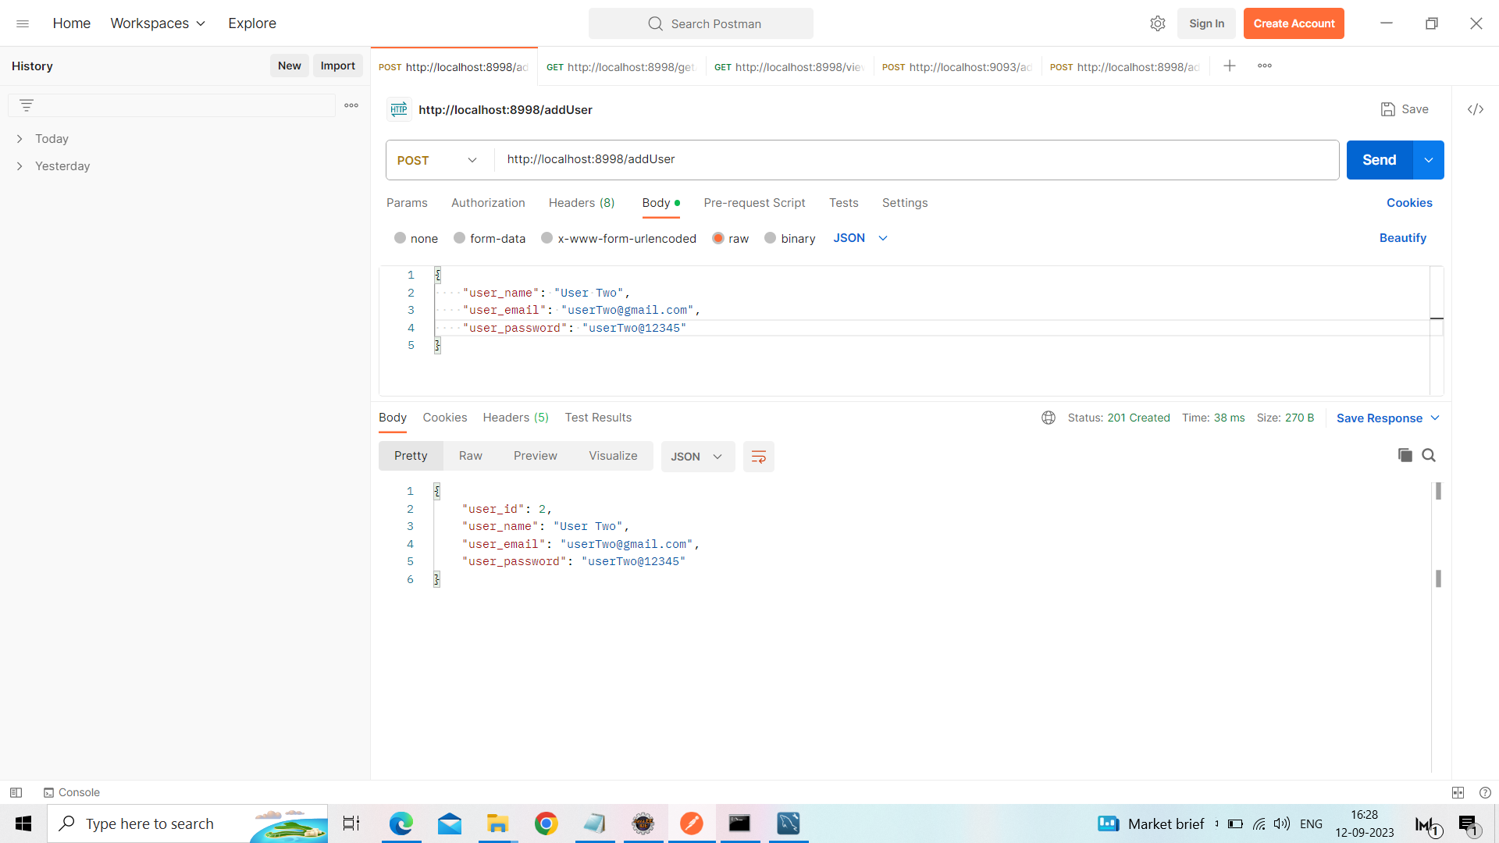
Add User

Slide 11
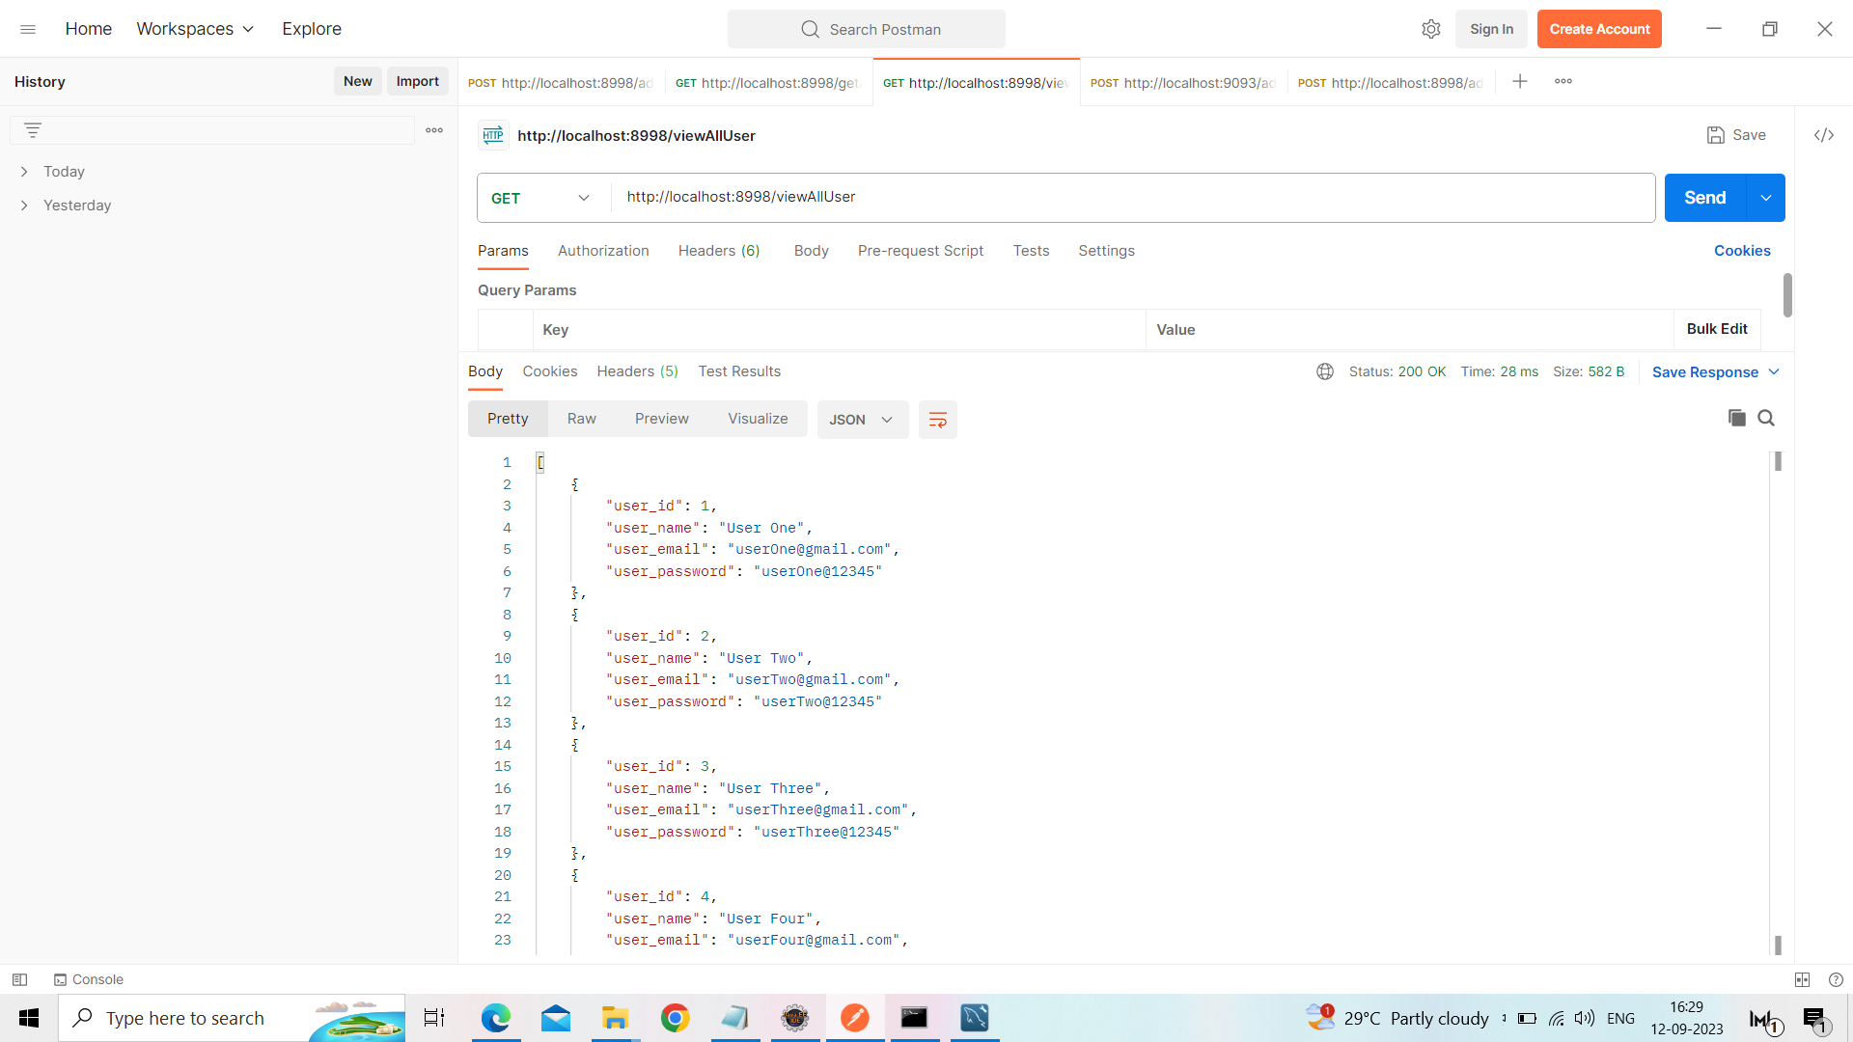
View All User

Slide 12
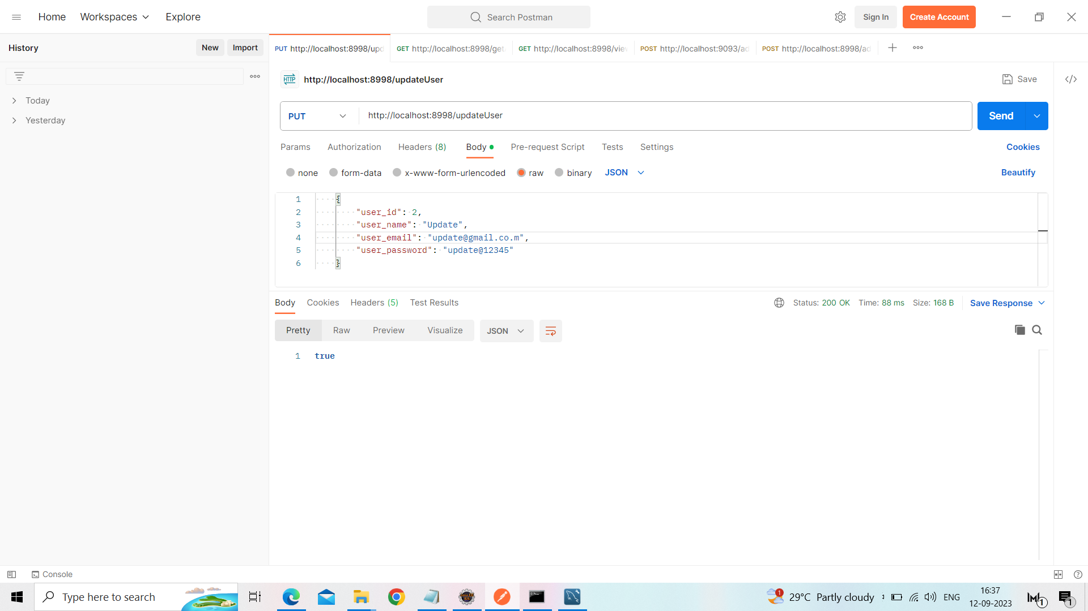
Update User Data

Slide 13
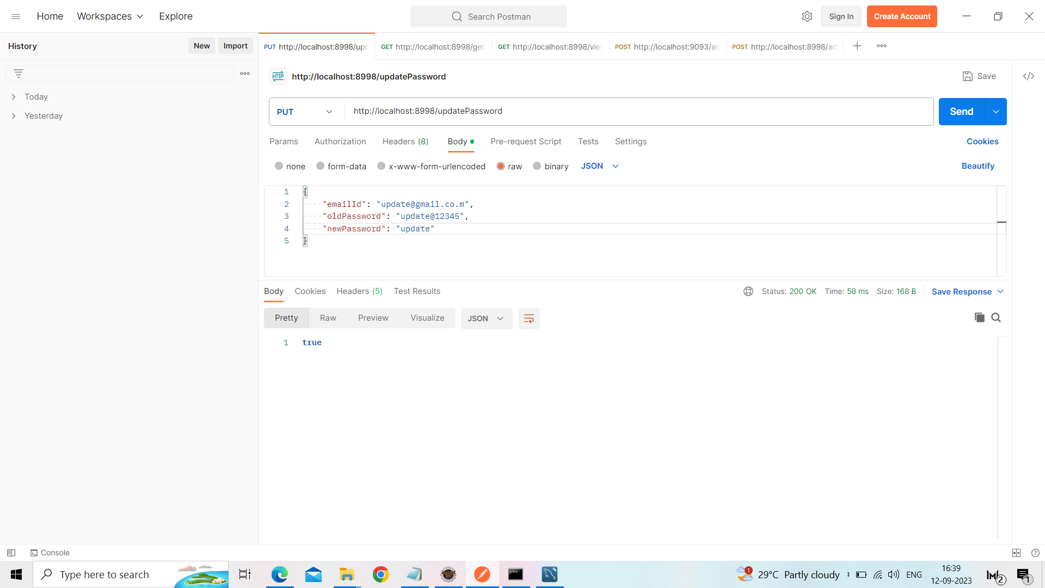
Update User Password

Slide 14
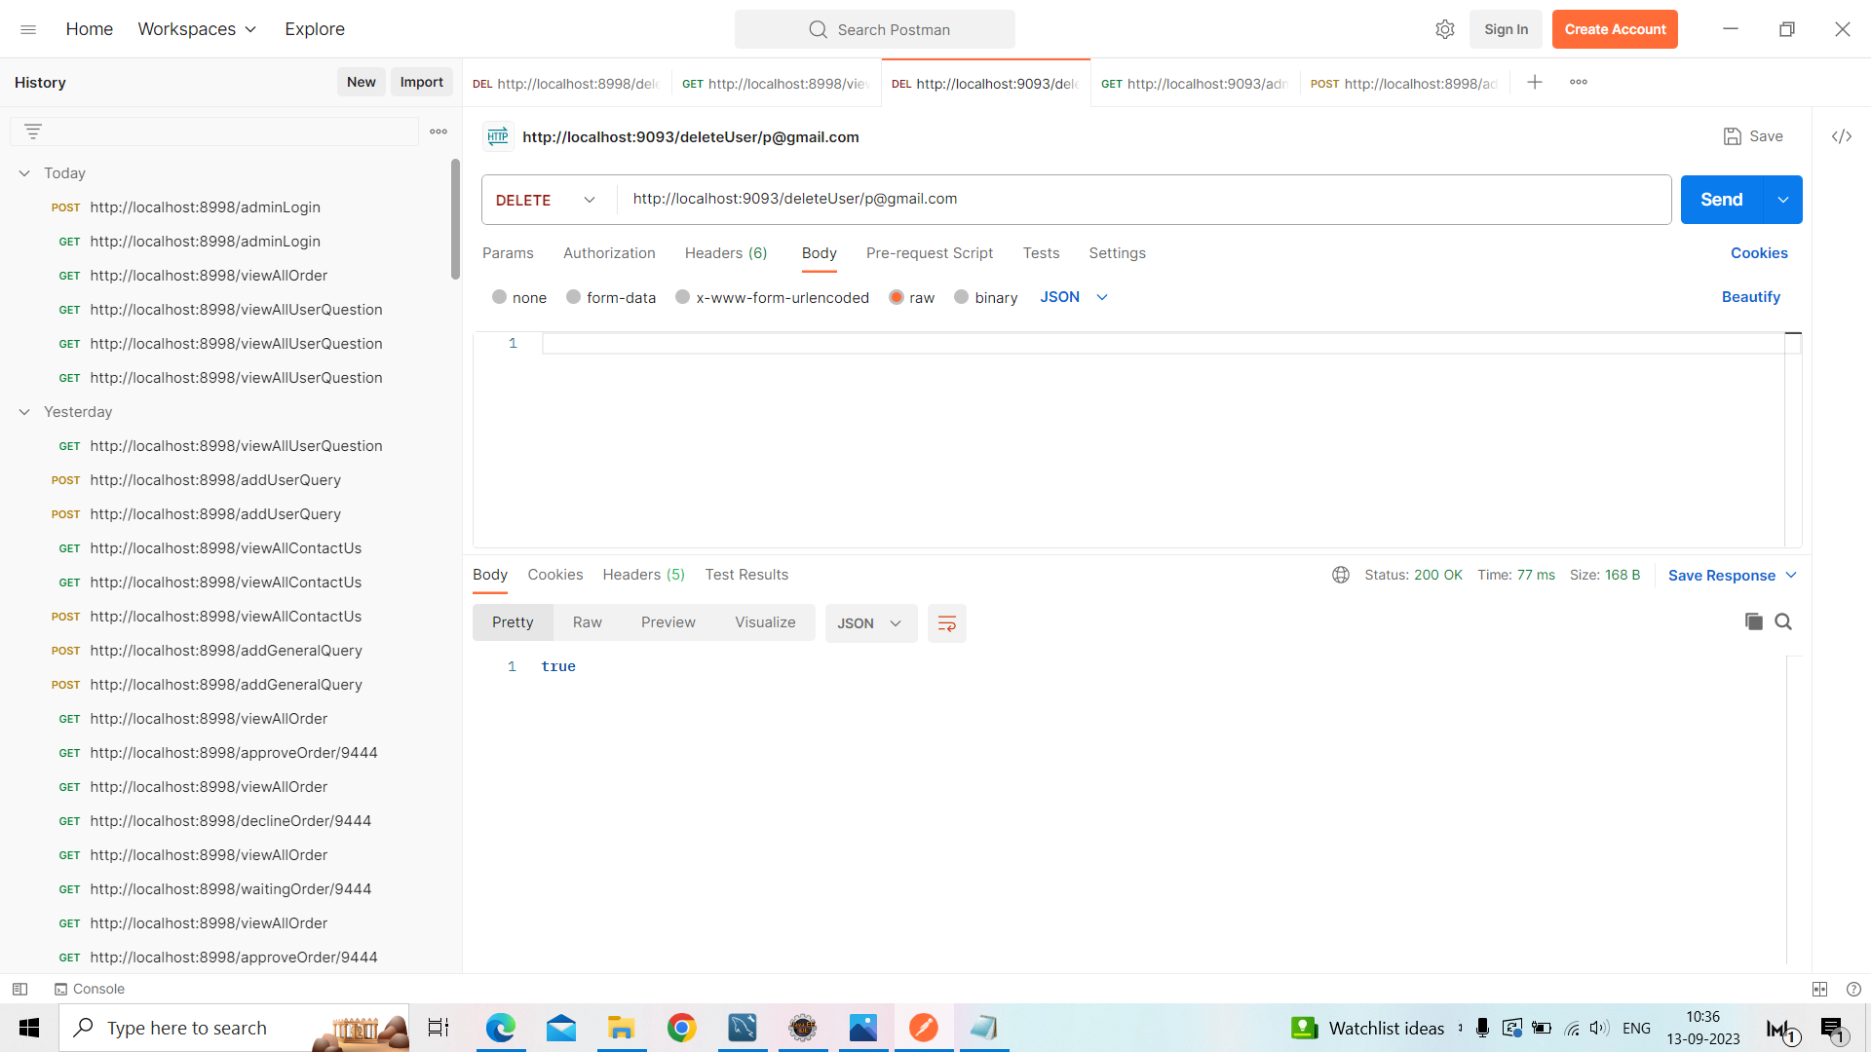
Delete User

Slide 15
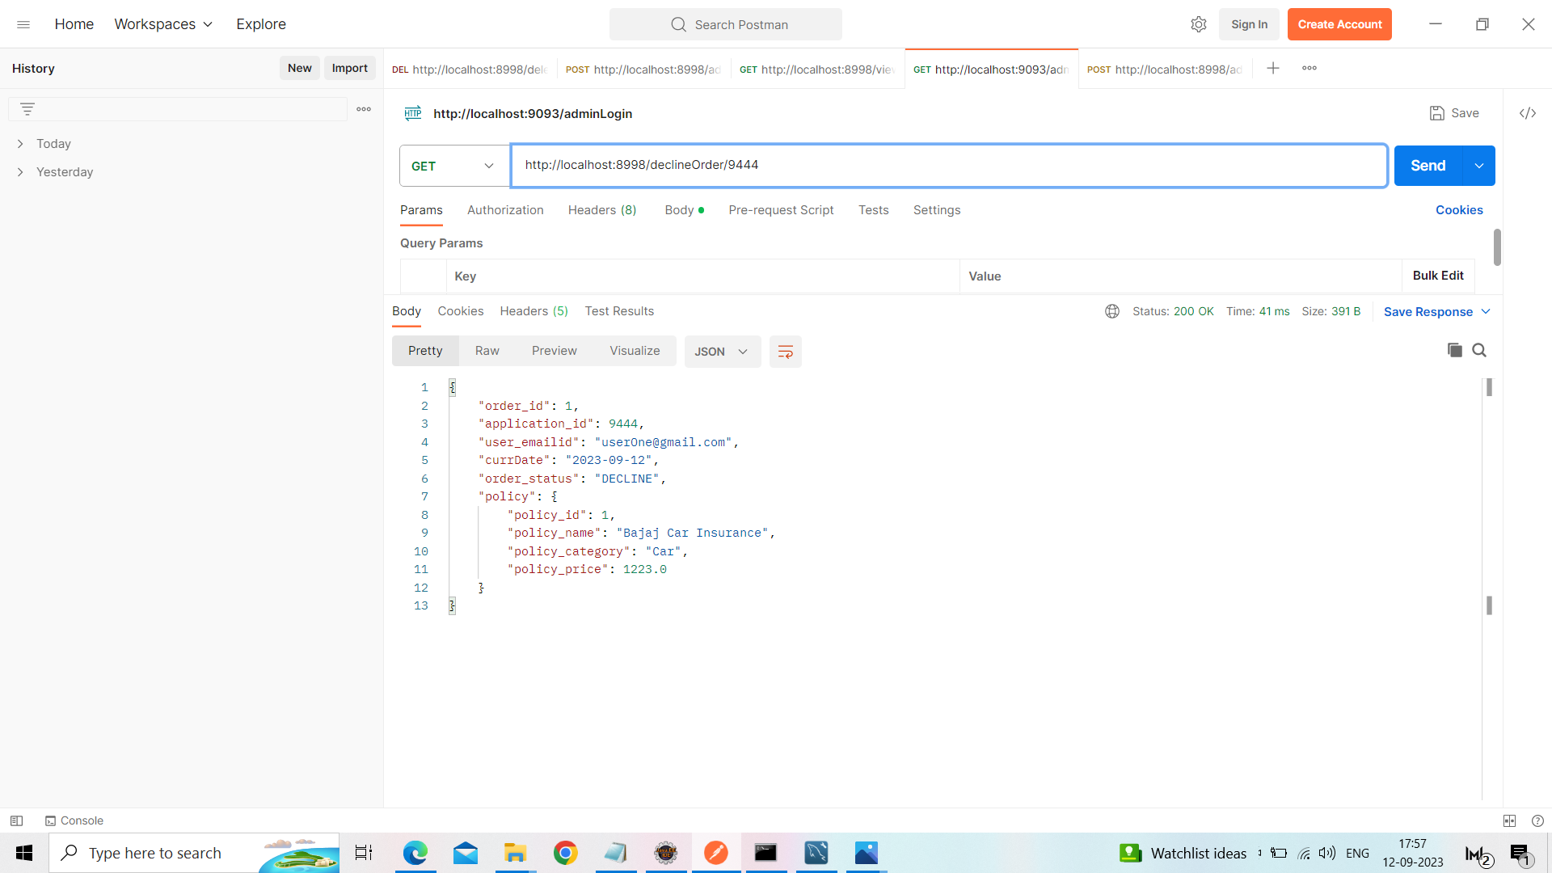
Decline Order

Slide 16
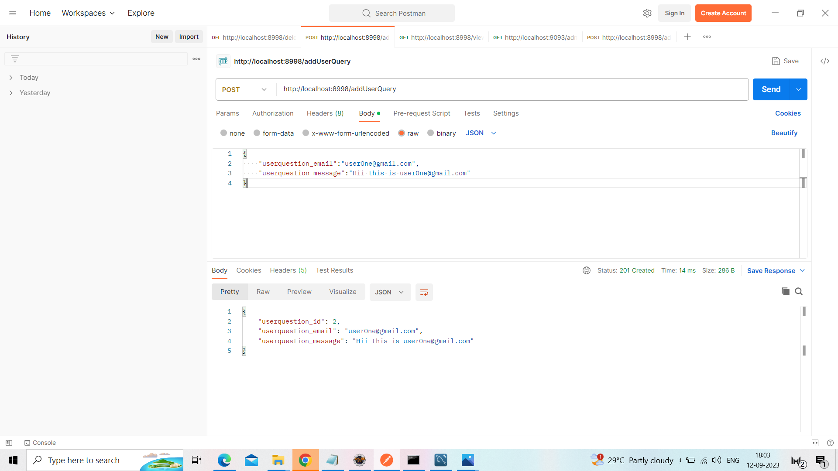
Add User Query

Slide 17
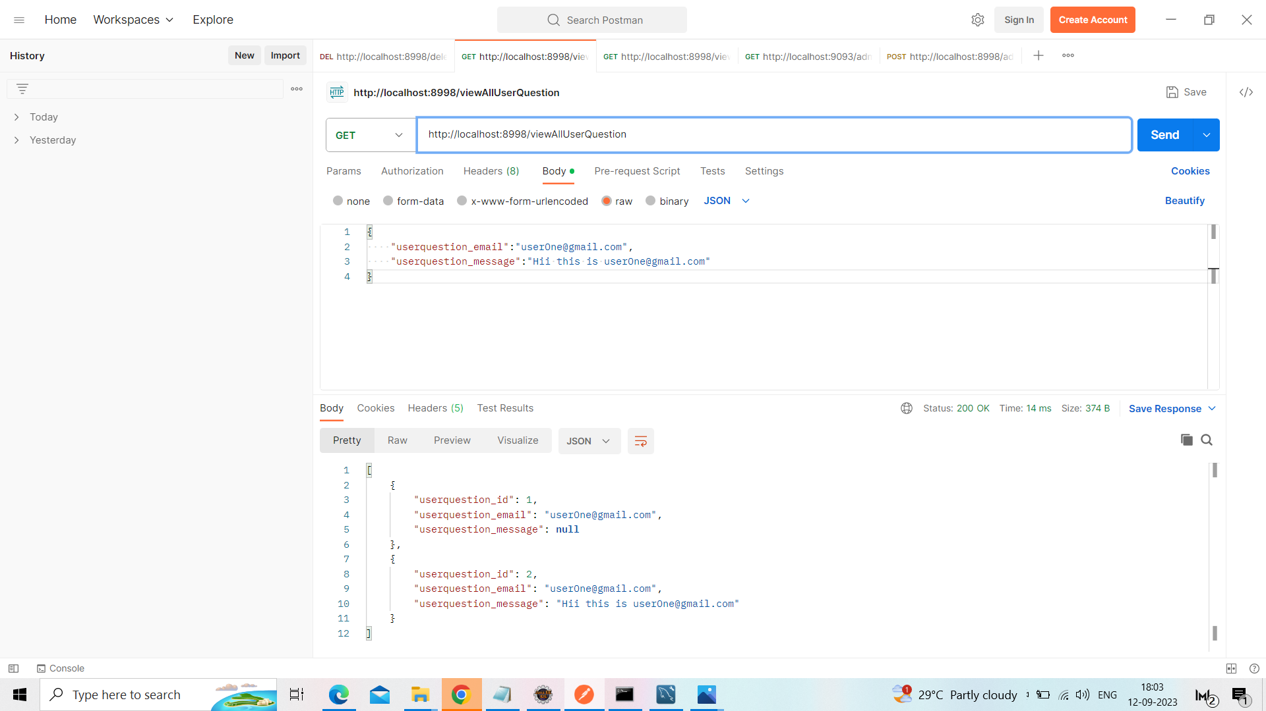
View All User Query

Slide 18
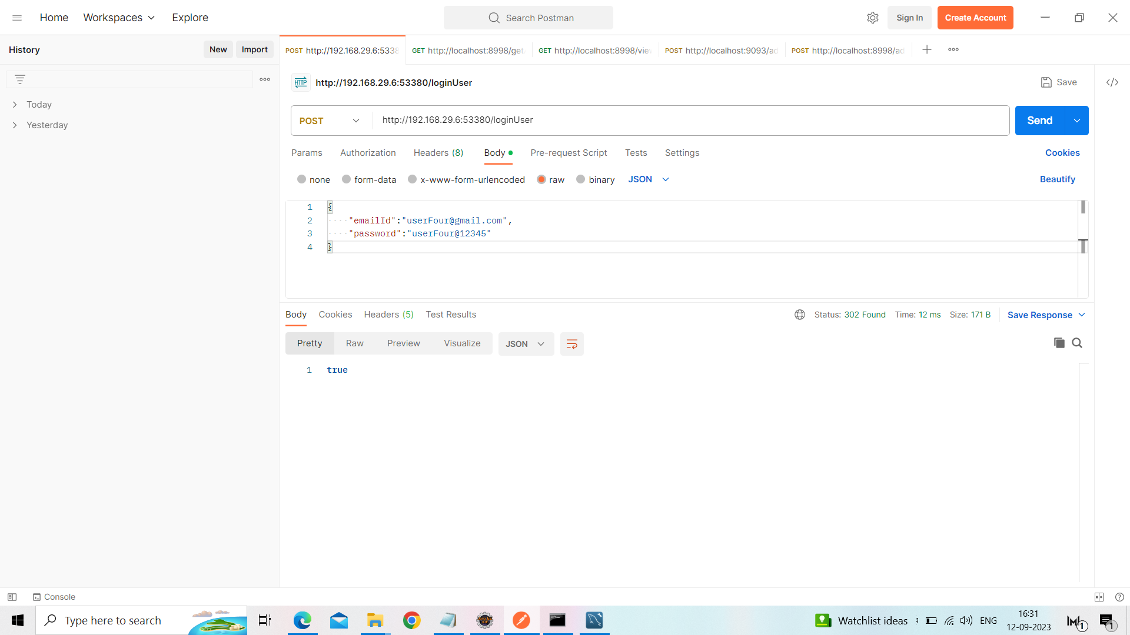
Login User

Slide 19
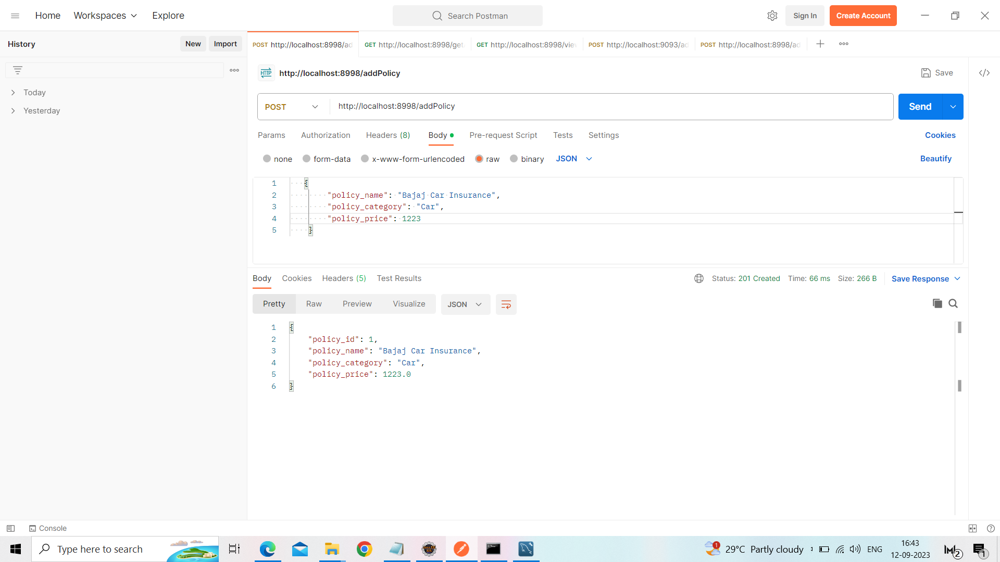
Add Policy

Slide 20
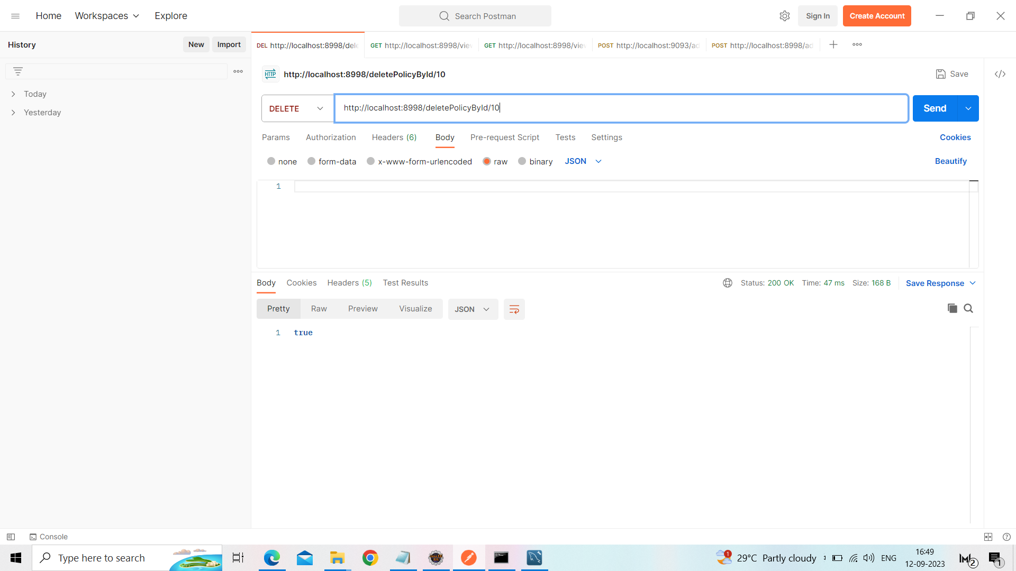
Delete Policy

Slide 21
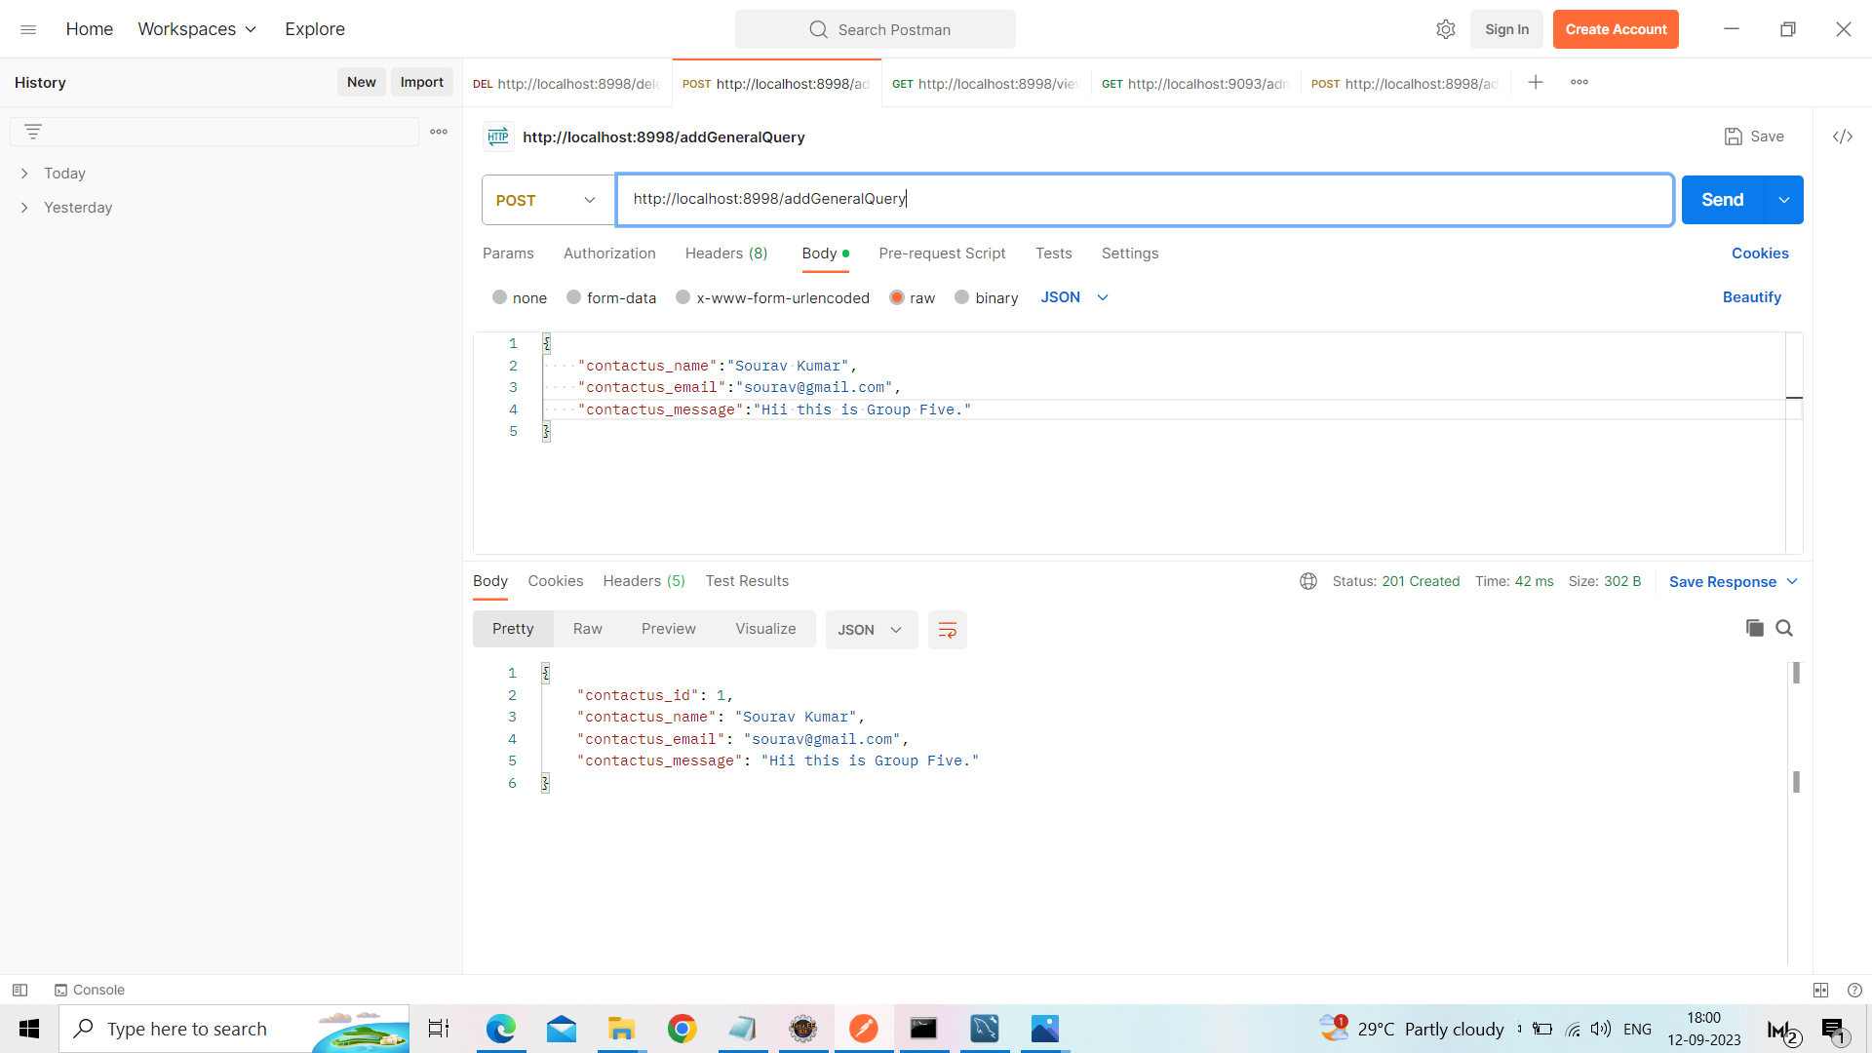
Add Contact Us

Slide 22

Update Policy

Slide 23
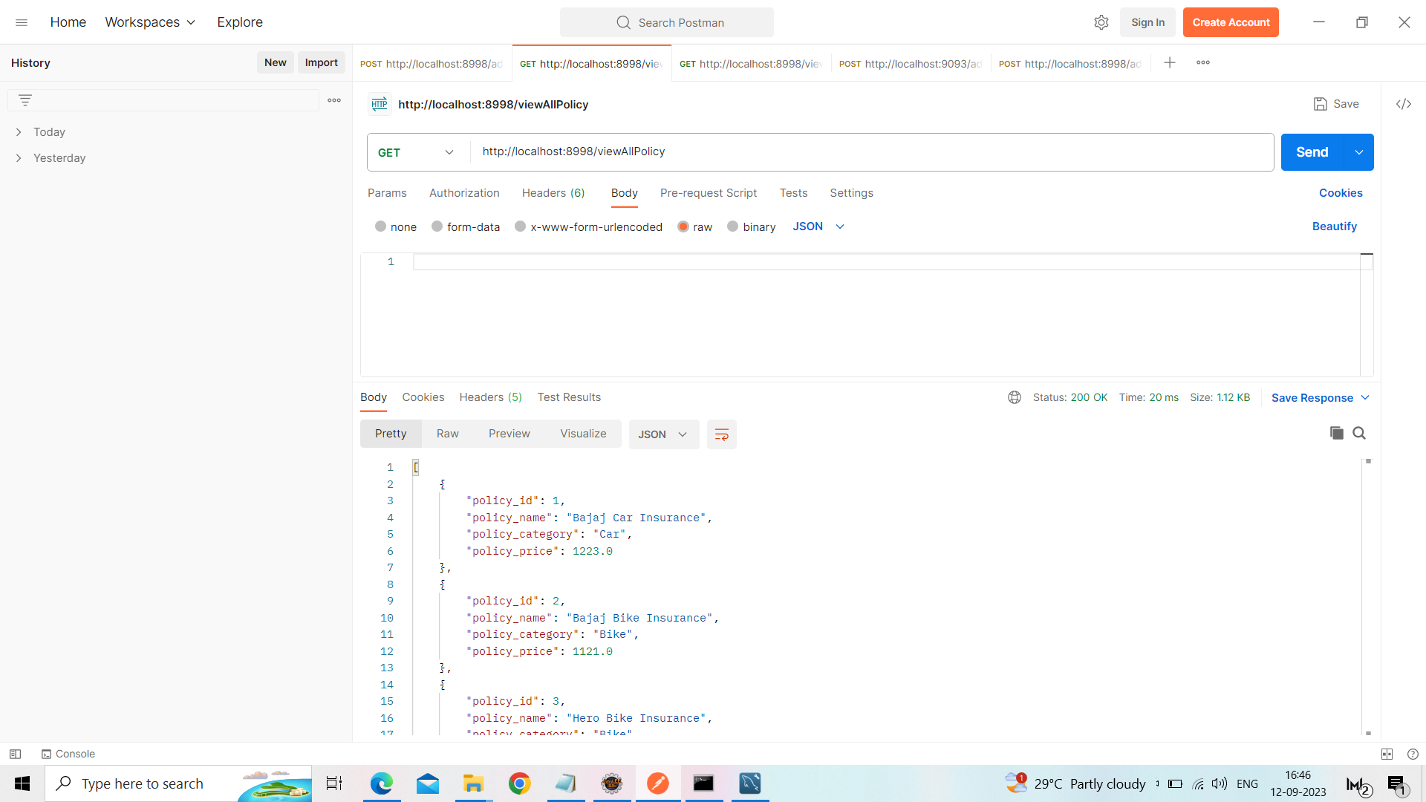
View All Policy

Slide 24
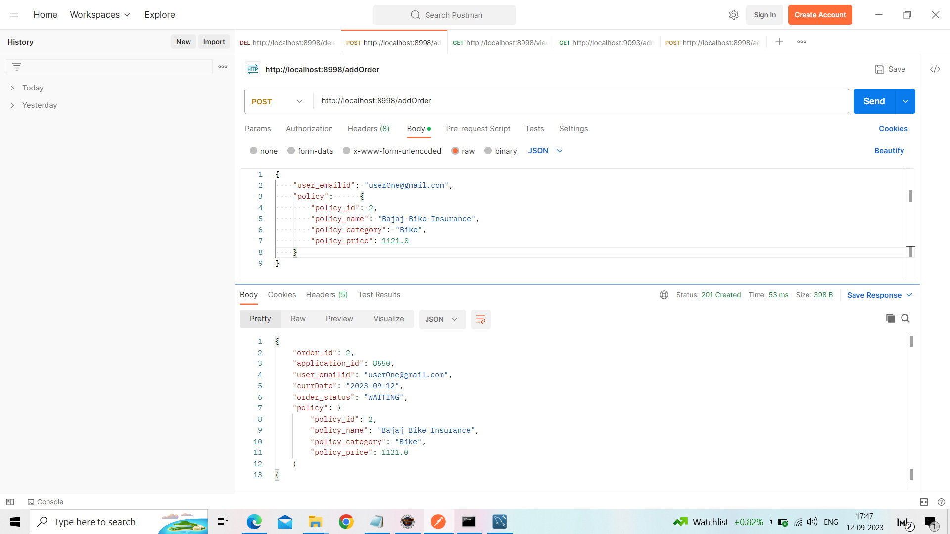
Add Order

Slide 25

Approve Order

Slide 26
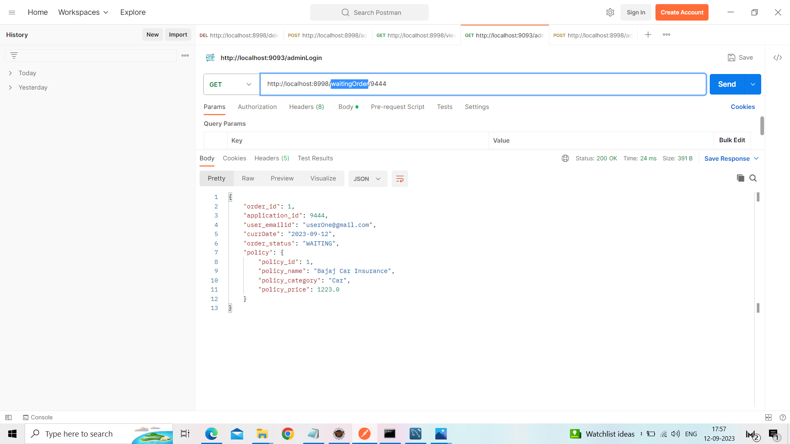
Waiting Order

Slide 27
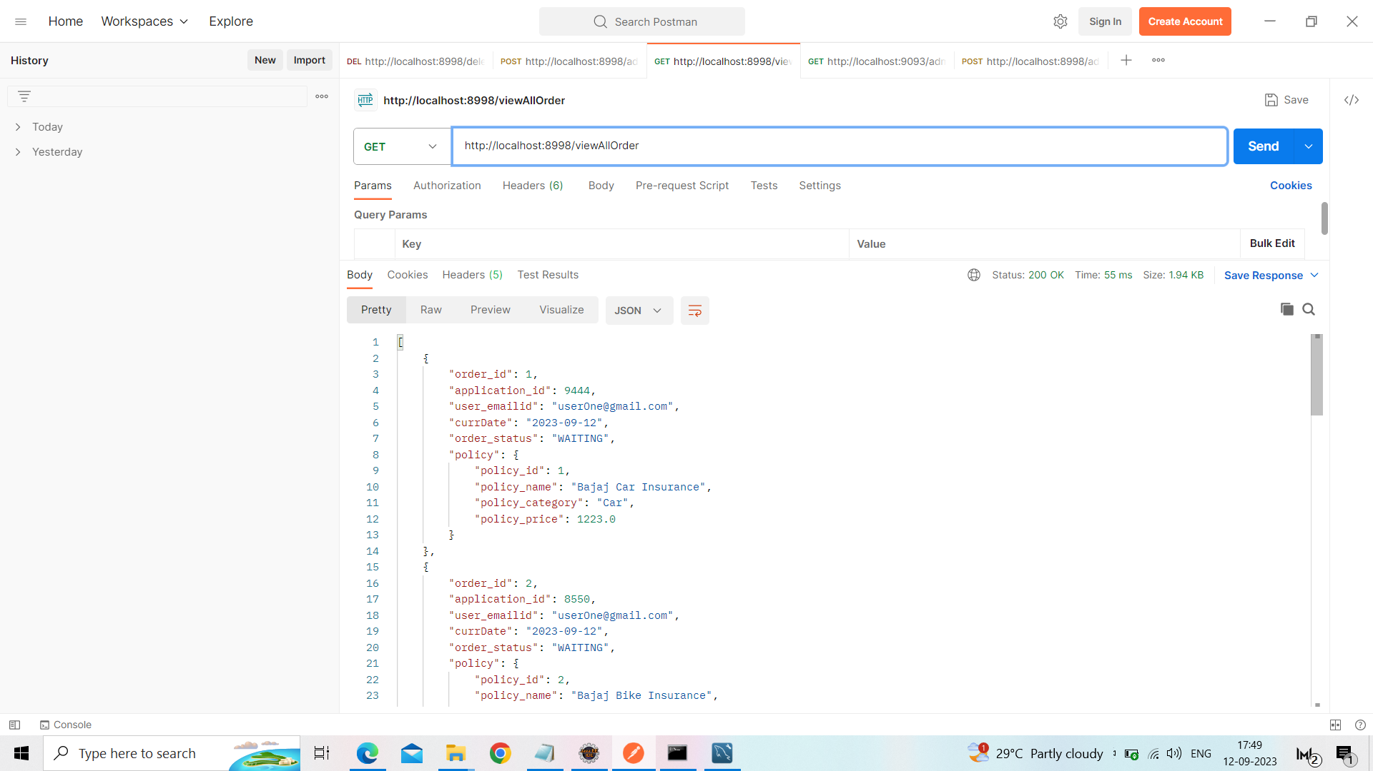
View All Order

Slide 28
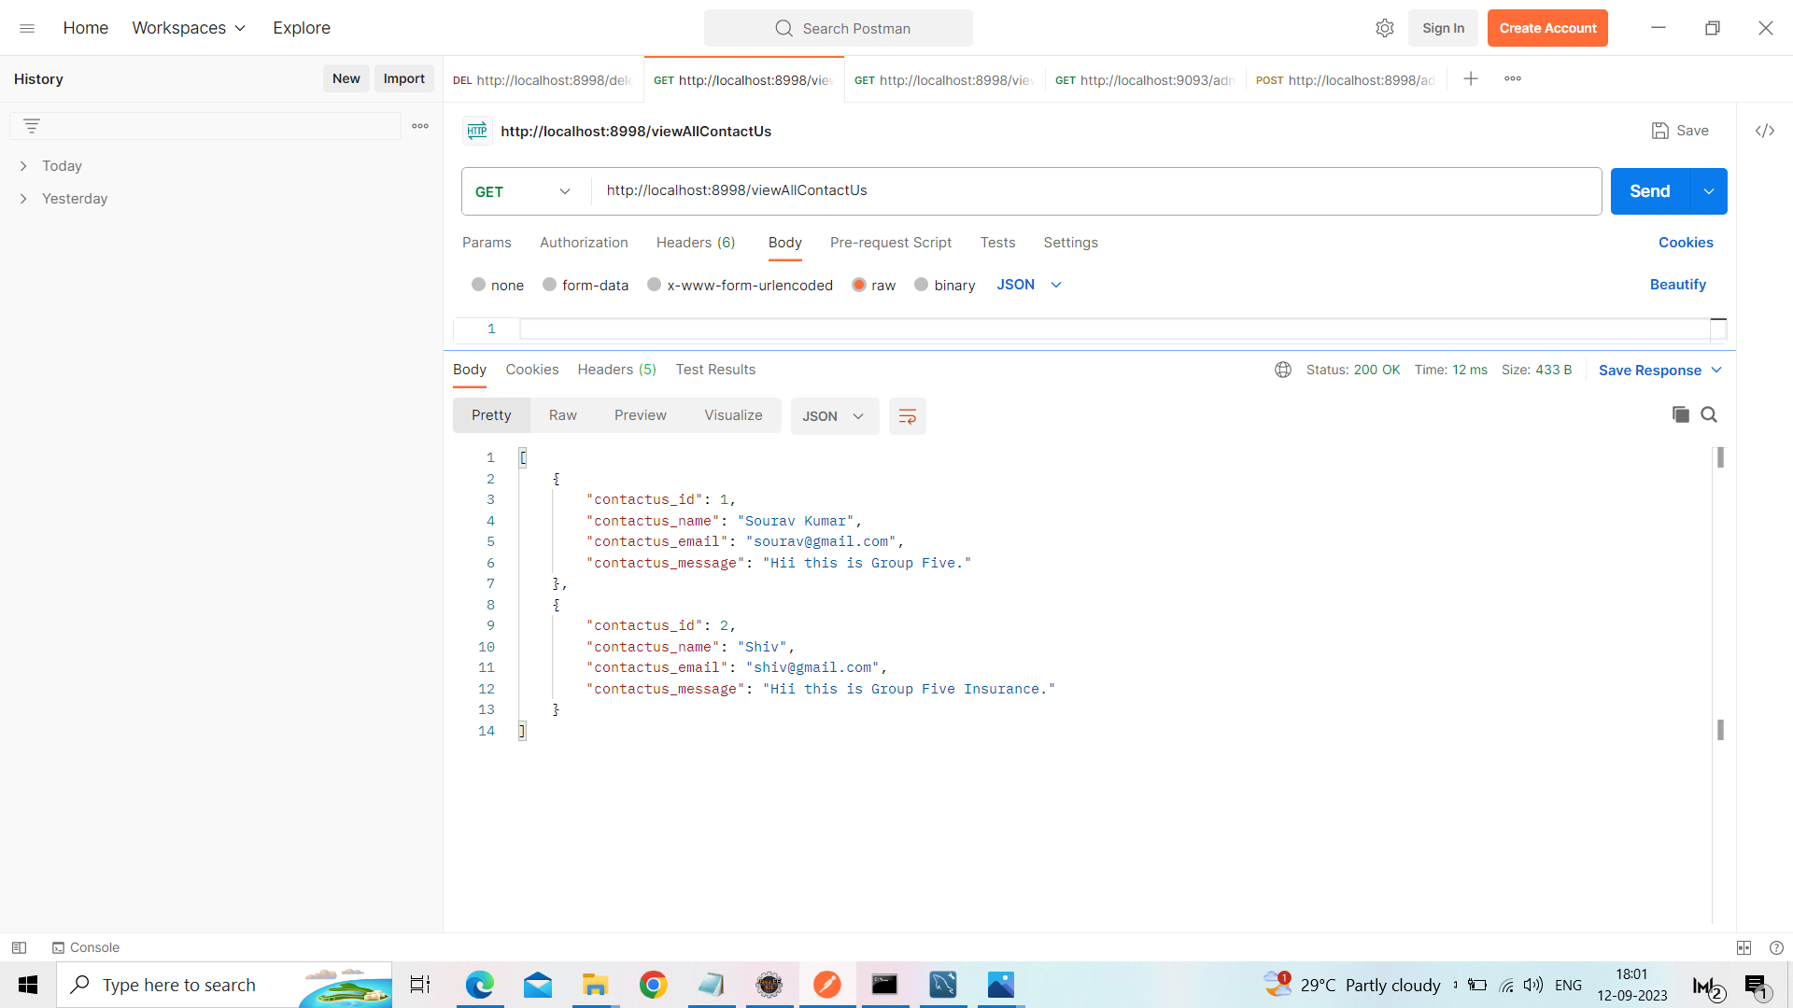
View All Contact Us

Slide 29

Admin Logut

Slide 30
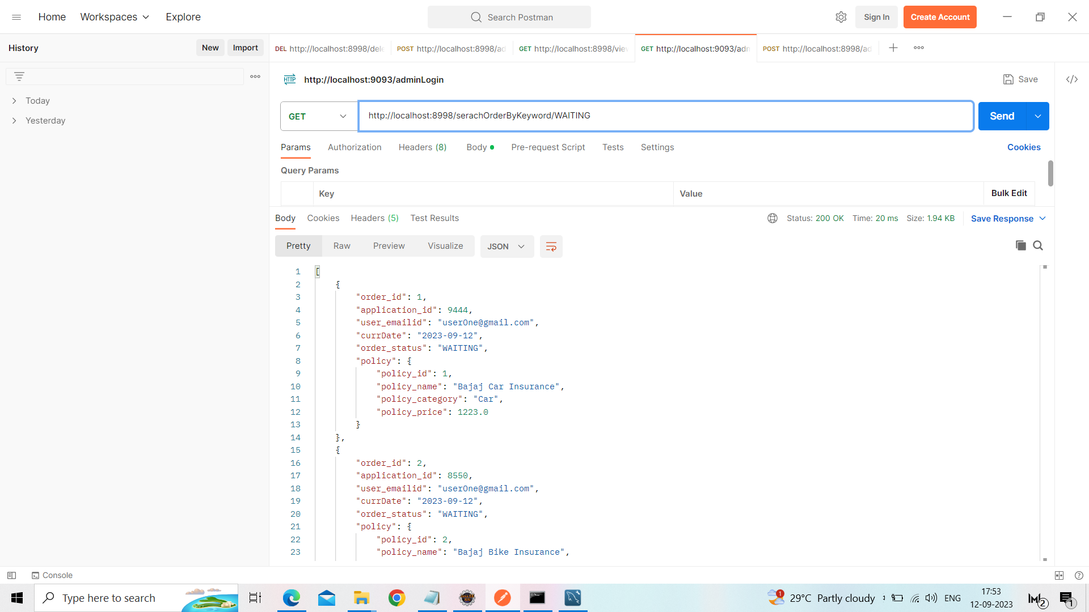
Search Order by keyword(id, email, order status)

Slide 31
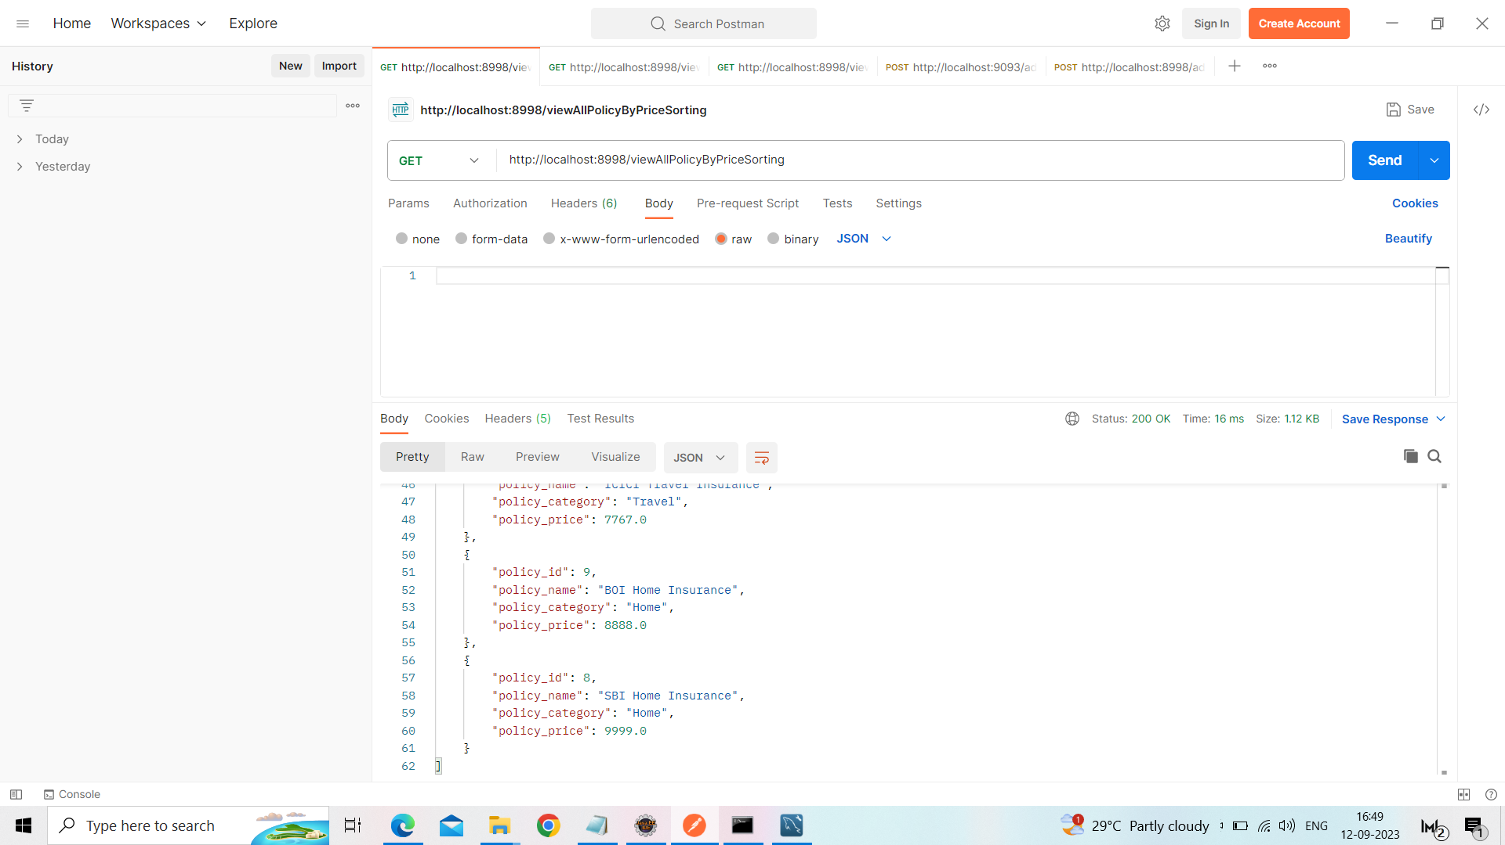
Sorting Policy by Price

Slide 32
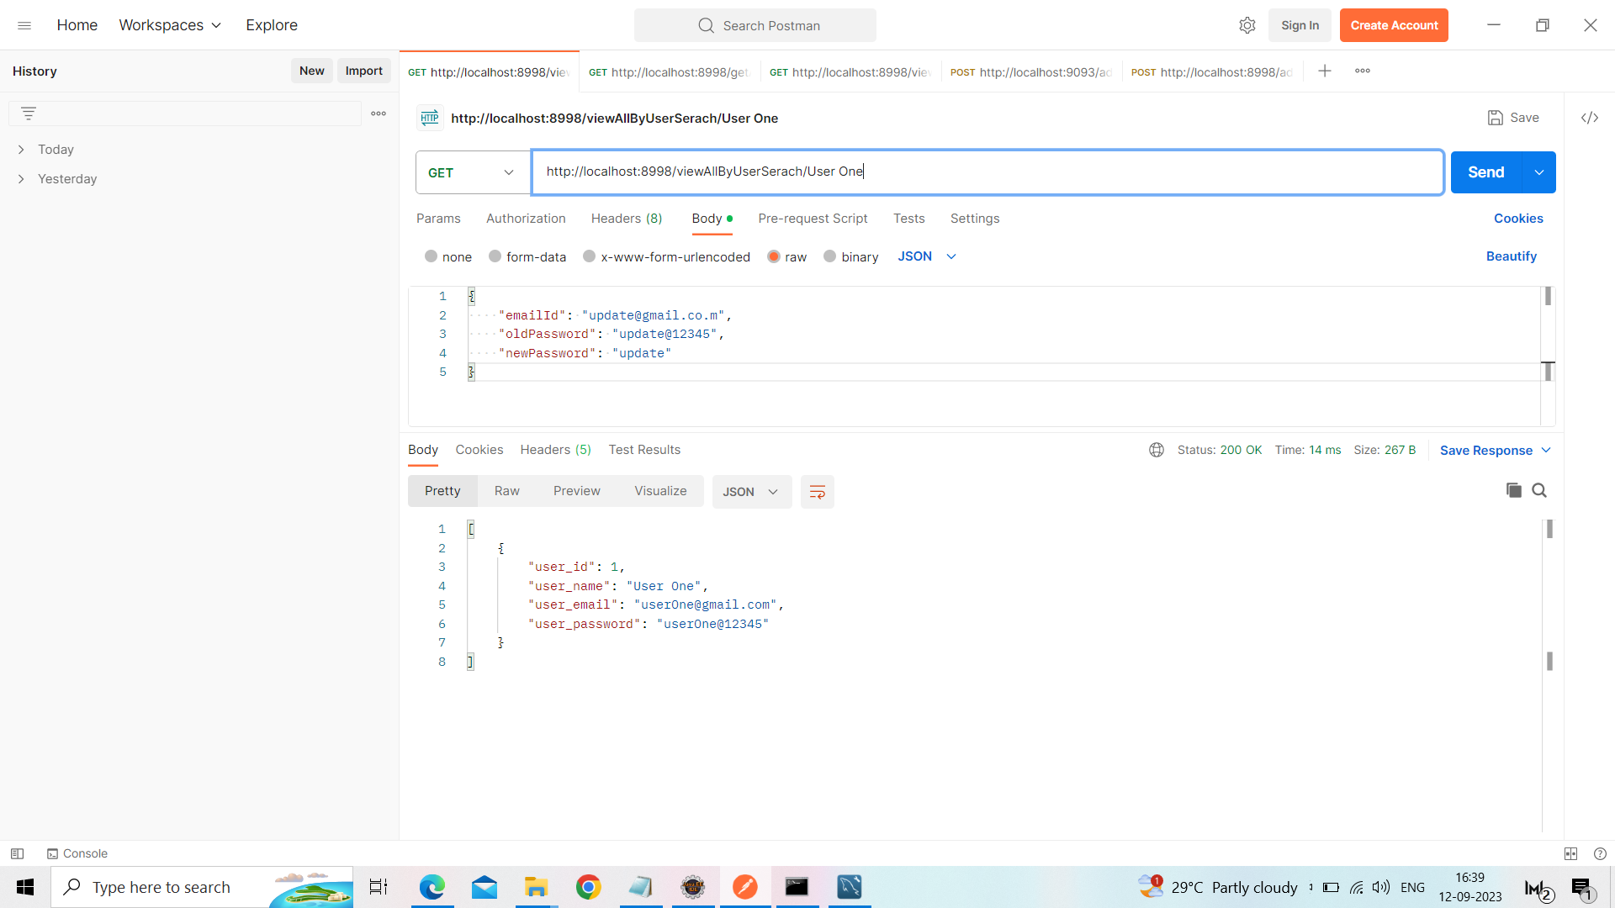
Search User by Keyword(name or email)

Slide 33
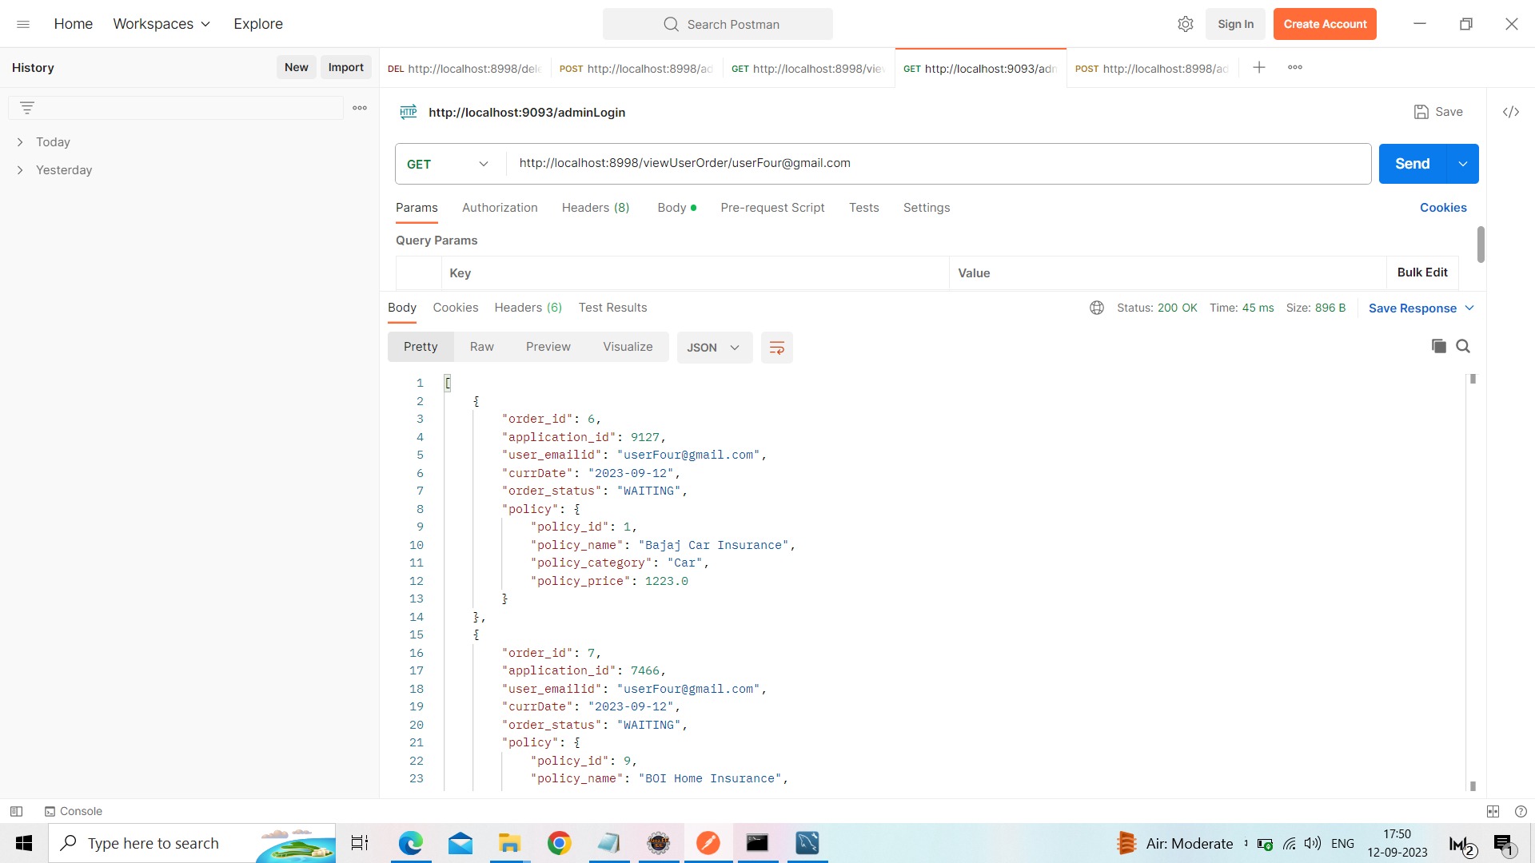
View User Order

